Slide 1
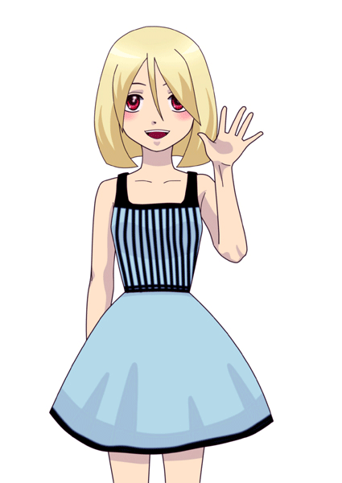
HELLO!
This is Shishira!

Slide 2
Name : Naga Shishira
NaYUdu Vasikarla.
Student number : 229606530.
Course name : 1701N

Slide 3

FAMILY
WE ARE A FAMILY OF THREE.

Slide 4
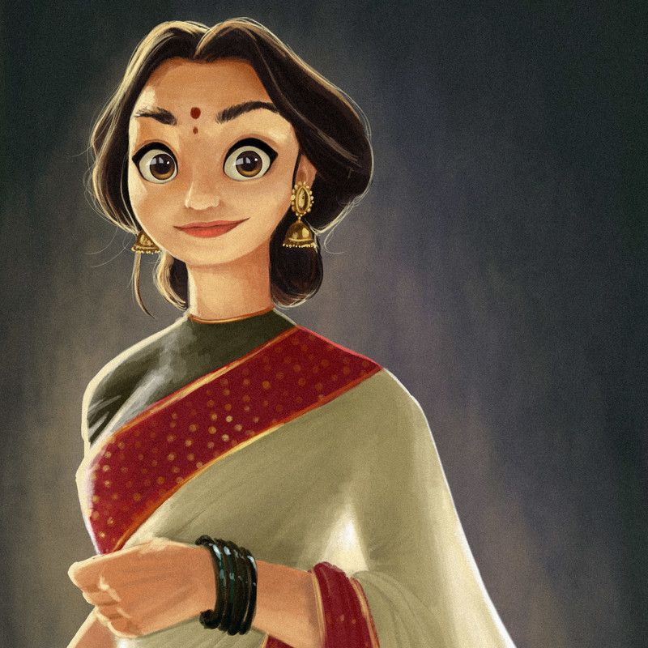

My Father is a Businessman.
My Mother runs a Clothing Business.
We are a typical South-Indian family.
I come from a city rich of history and culture, Warangal. A city in Telangana, India.

Slide 5
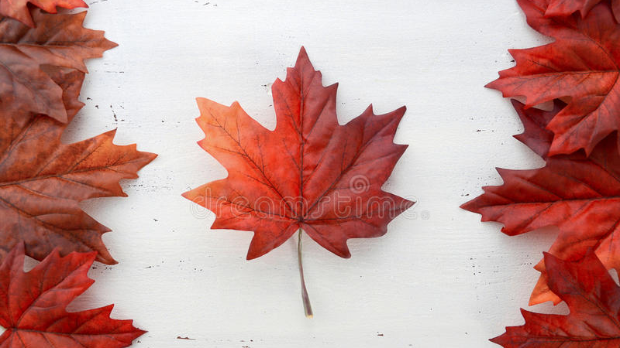
OBJECTIVE
I have come to Canada to pursue my bachelors in Computer Science.
I have always been fascinated by the world of computers and tech.
Thus, I migrated from my native country India to live independently and pursue a career of my dreams.

Slide 6
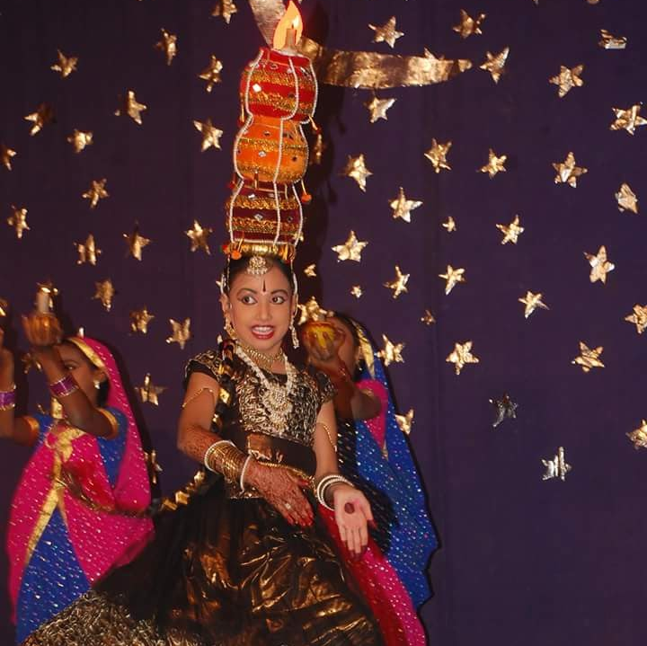
HOBBIES
I love to dance!
I express my emotions through my dance moves.
MY PERFORMANCE AT SCHOOL.

Slide 7
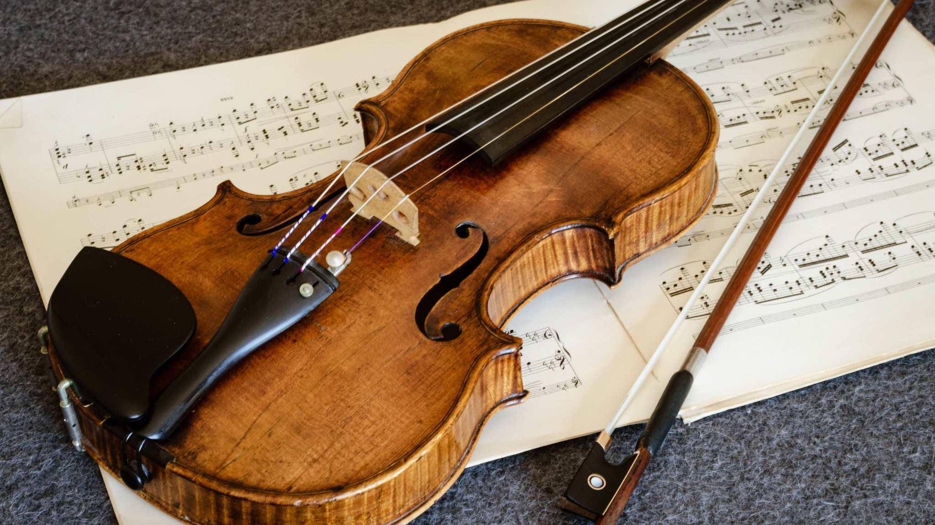
I Discovered my music interest through violin

Slide 8

Am a water baby!
I loved water since kid and enjoyed swimming in it.

Slide 9
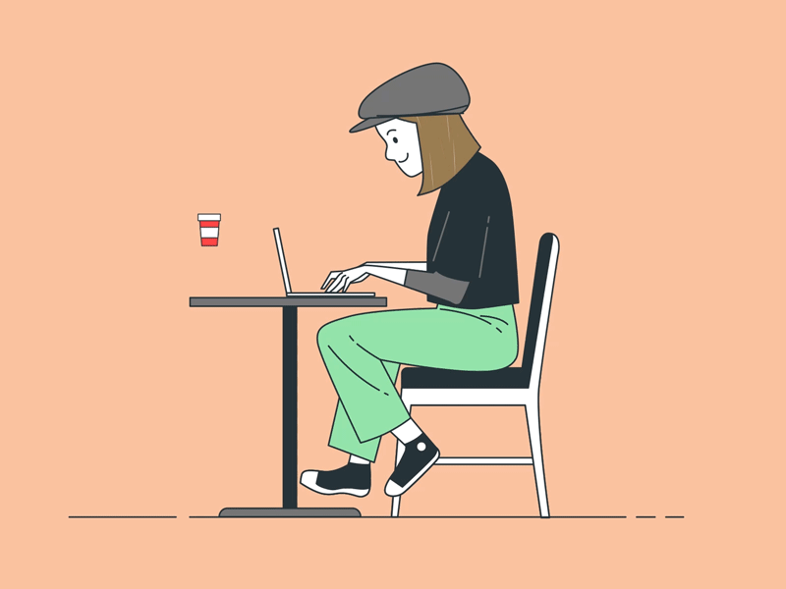
CODING
I LOVE TO CODE.
I code in JAVA, CPP, C, Python and enjoy web developing.
JAVA IS MY FAVOURITE!

Slide 10

Education. Finished my education till 12th in India.

Slide 11

GOALS
TO BE SELF RELIANT.
TO LEAD MY LIFE RIGHTEOUSLY.
TO GIVE BACK TO THE WELFARE OF THE SOCIETY.

Slide 12

STRENGTHS
I AM SPIRTUAL.
I AM KIND.
I LOVE TO ASK DOUBTS AND TRY TO LEARN NEW THINGS.
I AM NOT AFRAID TO BE DIFFERENT.
I TRY TO MAKE POSITIVE IMPACT ON LIVES OF PEOPLE AROUND ME.
YOGA.
FOR MIND, BODY AND SOUL.

Slide 13
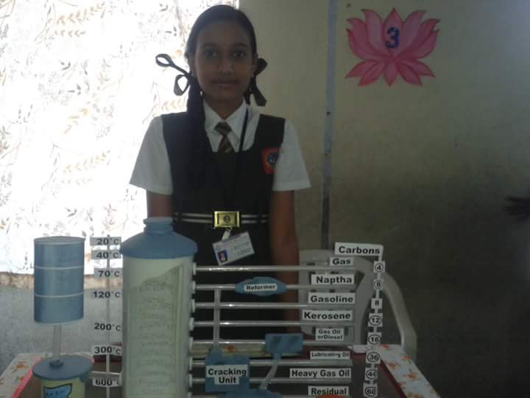
PROJECTS.
The Petroleum Factory.
I did this project back in 2016 for my school.
I explained the refining of petroleum.
The Petroleum Refinery Project.

Slide 14
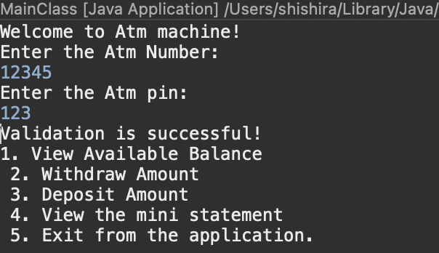

CODING PROJECTS.
The TIC TAC TOE game- using JAVA.
An ATM project – using JAVA.
Link to the projects:
https://github.com/shishira-vasikarla
THE FAMOUS MARIO GAME.

Slide 15
EXPERIENCE
ORGANISATION | WORK | DURATION | PLACE
SAHRUDAYA | VOLUNTARY | 2014 - 2018 | INDIA
Mallikamba Institute of Mentally Handicapped and Associated Disabilities. | VOLUNTARY | 2020 - Present | CANADA
WALMART | CAP 3 ASSOSCIATE | November 22 – April 23 | CANADA

Slide 16
REFERENCES.
FIGURE 1:A GIRL WAVING. From my PC.
FIGURE 2: THE FAMILY PICTURE. https://thumbs.dreamstime.com/z/family-people-silhouette-vector-father-mother-kid-happy-isolated-white-background-161493683.jpg.
FIGURE 3:THE ANIMATED DAD PICTURE. https://t4.ftcdn.net/jpg/01/23/88/95/360_F_123889510_GFrxhiKLsX5takwRYPKx21D8AdazGafM.jpg
FIGURE 4 THE ANIMATED MOM PICTURE: https://i.pinimg.com/originals/79/31/28/793128da0740ea4a4f92bc4164eae18c.jpg
FIGURE 5 THE CANADIAN FLAG PICTURE: https://thumbs.dreamstime.com/b/happy-canada-day-red-silk-leaves-shape-canadian-flag-white-shabby-chic-wood-table-55011539.jpg
FIGURE 6 MY DANCE PERFORMANCE : DOWNLOADED FRO MY PERSONAL GADGET.
FIGURE 7 THE SWIM PICTURE :
https://encrypted-tbn0.gstatic.com/images?q=tbn:ANd9GcRzHO4VVzFLO_Fpe-bNnOoOepYcV5OY-O9CaQ&usqp=CAU
FIGURE 8, THE GIRL CODING GIF : https://cdn.dribbble.com/users/4055494/screenshots/15215756/media/d2b66c4ca0192aa26d103448b3d1518b.gif
FIGURE 9, THE INDIAN FLAG : https://www.fg-a.com/flags/2021-indian-flag-waves.jpg

Slide 17
FIGURE 10, THE GIRL DOING YOGA: https://img.freepik.com/premium-vector/woman-meditating-peaceful-yoga-healthy-lifestyle-meditation-people-pose-spiritual-relax-flat-cartoon-design_561841-319.jpg?w=2000
FIGURE 11, I AM WITH PETROLEUM REFINERY PROJECT : DOWNLOADED FROM MY PERSONAL GADGET.
FIGURE 12 Tictactoe GAME : https://gfycat.com/gifs/search/tic+tac+toe
Google Drive Link for interview video: https://drive.google.com/drive/folders/1JSwjf-T_5G4IJBnadMjGfIDi-iyPtgnt?usp=share_link

Slide 18
THANK YOU!

